Slide 1
Azure Active Directory
Azure Active Directory, known as the Azure AD is Microsoft’s multi-tenant, cloud-based directory and identity management service.
Azure Active Directory (Azure AD) is a cloud-based identity and access management service.
If we want to manage access to the Azure Cloud application and associated resources then we need Azure AD.
For an organization, Azure AD helps employees sign up to multiple services and access them anywhere over the cloud with a single set of login credentials.
Azure AD is a Microsoft cloud-based identity and access management service, which helps your employees sign in and access resources in:
1) External resources, such as Microsoft Office 365, the Azure portal, and thousands of other SaaS applications.
2) Internal resources, such as apps on your corporate network and intranet, along with any cloud apps developed by your own organization.
Windows Active Directory (AD) was the previous version of Azure AD.

Slide 2
Why do we need Azure Active Directory?
All employees in an organization need access to some Azure services to perform their tasks.
They can access services like SQL database, machine learning, or Azure container services .
When the administrator assigns them separate user id and password for each service. Employees, as well as administrators, often find it hard to manage multiple user logins at the same time.
It creates more of a hassle for administrators working in an organization that involves more than 1000 employees.
This is where Azure Active Directory (AD) comes into the picture. With Azure AD, the administrators can handle multiple user logins without any issue.
Administrators need to assign a single username and password to access all the services they want.

Slide 3
Service Audience
There are three types of audiences in Azure active directory:
IT administrators
Application developers
Online customers
IT Administrators
IT administrators take care of all the sign-in procedures. They also solve issues related to authentication.
Application Developers
Application developers use these services to build applications. Development becomes quick since there are many resources available.
Online Customers
They make use of services like Office 365, CRM services, and have all their demands catered immediately.

Slide 4
Azure AD Terminology
Identity: A thing that can get authenticated. An identity can be a user with a username and password. Identities also include applications or other servers that might require authentication through secret keys or certificates.
Account: An identity that has data associated with it. You can’t have an account without an identity.
Azure AD Account: An identity created through Azure AD or another Microsoft cloud service, such as Microsoft 365. Identities are stored in Azure AD and accessible to your organization's cloud service subscriptions. This account is also sometimes called a Work or school account.
Azure Tenant: A dedicated and trusted instance of Azure AD. The tenant is automatically created when your organization signs up for a Microsoft cloud service subscription. These subscriptions include Microsoft Azure, Microsoft Intune, or Microsoft 365. An Azure tenant represents a single organization.
Single-tenant: Azure tenants that access other services in a dedicated environment are considered single tenant.
Multi-tenant: Azure tenants that access other services in a shared environment, across multiple organizations, are considered multi-tenant.

Slide 5
Azure AD Terminology
Azure AD Directory: Each Azure tenant has a dedicated and trusted Azure AD directory. The Azure AD directory includes the tenant's users, groups, and apps and is used to perform identity and access management functions for tenant resources.
Azure subscription: Used to pay for Azure cloud services. You can have many subscriptions and they're linked to a credit card.
Custom domain: Every new Azure AD directory comes with an initial domain name, for example domainname.onmicrosoft.com. In addition to that initial name, you can also add your organization's domain names. Your organization's domain names include the names you use to do business and your users use to access your organization's resources, to the list. Adding custom domain names helps you to create user names that are familiar to your users, such as alain@contoso.com.
Microsoft account (also called, MSA):Personal accounts that provide access to your consumer-oriented Microsoft products and cloud services. These products and services include Outlook, OneDrive, Xbox LIVE, or Microsoft 365. Your Microsoft account is created and stored in the Microsoft consumer identity account system that's run by Microsoft.

Slide 6
Features of Azure AD
Authentication: To access various services, identification verification is necessary. Including capabilities like multifactor authentication and self-service password reset is also part of Azure AD.
Single sign-on: With single sign-on (SSO), you can log into various applications with just one login and password.
Application management: Using Azure AD, you can manage both your on-premises and cloud-based apps.
Device management: Azure AD provides the registration of devices in addition to accounts for specific individuals. It also enables device-based Conditional Access restrictions to limit access attempts to only those coming from known devices.

Slide 7
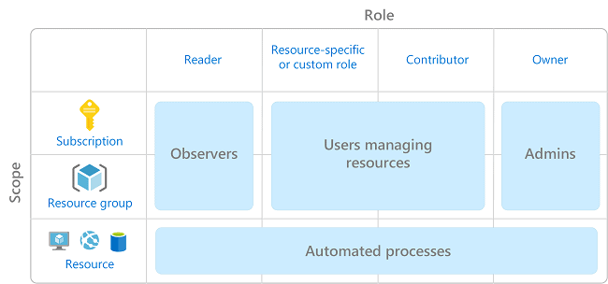
Access To Azure Resources
It is a very difficult and important task for any organization to manage access to Azure resources.
Role-based access control (RBAC) helps you manage who has access to Azure resources, what they can do with those resources, and what areas they have access to.
RBAC is an authorization system built on Azure Resource Manager that provides fine-grained access management of Azure resources.
We can segregate duties and the amount of access to the users in a team that they need to perform their tasks using RBAC.
It’s a best practice to grant users the least privilege to get their work done.

Slide 8
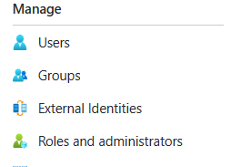
Users, Groups, And Roles
Users, Groups, And Roles are three features that play a major role while coming to Azure Active Directory.
Using Azure Active Directory you can create a user or add the users to the groups and assign the roles to groups, users, and services.

Slide 9
Users, Groups, And Roles
Users
By using the Azure AD of users feature you can create a new user with all the permissions required for the user like how many services he can access and the level of permissions he can have.
The users can be employees of the same organization or they can be freelancers with very less amount permissions. And also can manage the permission to users for certain permission which they can perform on Virtual Machines, Azure functions, Azure Logic Apps and etc.
Groups
A group is a collection of users, and a single person can be a member of multiple groups. With the aid of groups, we can manage permissions for many users quickly and efficiently.
Instead of managing the permissions individually, you can merge all the users into one group and maintain the permission in bulk.

Slide 10
Benefits Of Using Azure AD
Data Protection: The protection of data will be increased by using Azure AD it will restrict the users, and services from accessing the resources which are available in Azure Cloud without permission.
Remote Access: Once you created the user and give the credentials to the employee he can access Microsoft Azure from anywhere in the world without any threats.
Easy Reset of Password: Azure AD will allow users to reset their password without any help from the IT desk by following some simple steps.
Identity Protection and Grovence: Azure AD will protect unusual logins you can manage the user accounts of multiple employees from a single place.
Cost: Azure AD will charge only for the service you are going to use you can purchase the subscription plan based on your organization’s needs.

